Slide 1

Data Management Planning
Jonathan Rans
Digital Curation Centre, Edinburgh
J.Rans@ed.ac.uk
Twitter: @JNRans
Introduction to Open Science and developing RDM services, Riga, Latvia

Slide 2
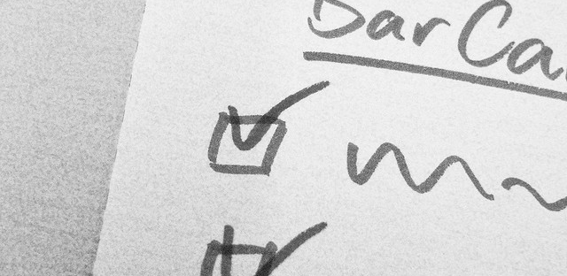
data management planning
Helping researchers to plan effectively
Image CC-BY-NC-SA by Ralf Appelt www.flickr.com/photos/adesigna/4090782772

Slide 3
What is a data management plan?
A brief plan written at the start of a project to define:
  how will data be created?
  how will it be documented?
  who will access it?
  where will it be stored?
  whether (and how) will it be shared & preserved?
DMPs are often submitted as part of grant applications, but are useful whenever researchers are creating data.

Slide 4
Why develop a DMP?
They can help researchers to:
  Make informed decisions that anticipate & avoid problems
  Avoid duplication, data loss and security breaches
  Provide guidelines for everyone working on the project
  Comply with funder requirements…

Slide 5
Horizon 2020 templates
Annex 1
(by month 6)
Annex 2
(mid-term & final review)
The DMP should address the points below on a dataset by dataset basis:
Data set reference and name
Data set description
Standards and metadata
Data sharing
Archiving and preservation (including storage and backup)
Scientific research data should be easily:
1. Discoverable
2. Accessible
3. Assessable and intelligible
4. Useable beyond the original purpose for which it was collected
5. Interoperable to specific quality standards
http://ec.europa.eu/research/participants/data/ref/h2020/grants_manual/hi/oa_pilot/h2020-hi-oa-data-mgt_en.pdf

Slide 6
Info on RDM: what and when
PROPOSAL STAGE
IN PROJECT
Where relevant*, H2020 proposals can include a section on data management which is evaluated under the criterion ‘Impact’
What types of data will the project generate/collect?
What standards will be used?
How will this data be shared/made available? If not, why?
How will this data be curated and preserved?
* For “Research and Innovation actions” and “Innovation Actions”
DMPs are a project deliverable for those participating in the open data pilot.
Not a fixed document – should evolve and gain precision
  Deliver first version within initial 6 months of project
  More elaborate versions whenever important changes to the project occur. At least at the mid-term and final review.
Notes:
Although DMPs are a project deliverable and not required at the application stage, proposals can include a section on data management if desired. The info suggested here is similar to the preliminary DMP, so essentially gets that started.
6

Slide 7
Initial DMP (at 6 months)
The DMP should address the points below on a dataset by dataset basis:
Data set reference and name
  Identifier for the data set to be produced
Data set description
  Description, origin and scale of the data that will be generated or collected, and to whom it could be useful
  Information on the existence (or not) of similar data and the possibilities for integration and reuse
Standards and metadata
  Reference to existing suitable standards of the discipline. If these do not exist, an outline of how and what metadata will be created.
Data sharing
  How the data will be shared - widely open or restricted to specific groups – or reasons why it cannot be shared
  Access procedures, embargo periods (if any), and technical mechanisms for dissemination
  Software and other tools necessary for re-use
  Repository where data will be stored
Archiving and preservation (including storage and backup)
  Procedures for long-term preservation
  How long the data should be preserved
  Final data volume
  How associated costs will be covered
Notes:
This template should be filled in for each dataset
7

Slide 8
More elaborate DMP
Scientific research data should be easily:
1. Discoverable
  Are the data and software discoverable and identifiable by a standard mechanism e.g. DOIs?
2. Accessible
  Are the data accessible and under what conditions e.g. licenses, embargoes etc?
3. Assessable and intelligible
  Are the data and software assessable and intelligible to third parties for peer-review? E.g. can judgements be made about their reliability and the competence of those who created them?
4. Useable beyond the original purpose for which it was collected
  Are the data properly curated and stored together with the minimum software and documentation to be useful by third parties in the long-term?
5. Interoperable to specific quality standards
  Are the data and software interoperable, allowing data exchange? E.g. were common formats and standards for metadata used?
Notes:
The second template is provided based on the G8 principles and focuses on the qualities/properties needed. These are that scientific research data should be easily discoverable, accessible, assessable and intelligible, usable beyond the original purpose for which it was created, and interoperable to specific quality standards.
8

Slide 9
Key things to check
Is the plan appropriate?
  adopting relevant standards
  practices in line with norms for that field
  use of support services e.g. university storage, subject repositories…
Does it seem feasible to implement?
Has sufficient information been provided?
Has advice been sought where needed?
Are restrictions and costs properly justified?

Slide 10
Main judgement to make:
Has the researcher taken time to reflect on what to do?
There are no absolute right answers. You just want to be reassured that due consideration has been given and the approach seems reasonable.

Slide 11
Data Description
Is it clear what data will be collected?
Are appropriate file formats proposed?
Has the reuse or integration of existing data been considered? (if appropriate)
If third-party data will be reused, has sharing been considered in the licence agreements?

Slide 12
Standards and Metadata
Will enough contextual information and structured metadata be provided to allow others to find, understand and reuse the data?
Will the data be documented during the research? Has time been allocated to this?
Will formal standards be used? (where available)
Is information being captured & shared on the associated software and tools needed for reuse and reproducibility?

Slide 13
Data Sharing
Is it clear which data will be shared and with whom?
  Are opportunities to share data openly maximised? e.g. by seeking consent to share, anonymising data…
  If data can’t be shared, are the reasons why explained?
Will the data be easily accessible and openly licensed?
If an embargo period is planned, is that in line with norms for that discipline?
Will persistent IDs be assigned for discovery and citation?

Slide 14
Archiving and Preservation (incl. storage)
Will the research data be deposited in a suitable community database, repository or archive?
Are there any costs associated with preservation, and if so, how will these be covered?
Will the data be stored and backed-up appropriately during the research project? e.g. on managed university filestores rather than external hard drives

Slide 15
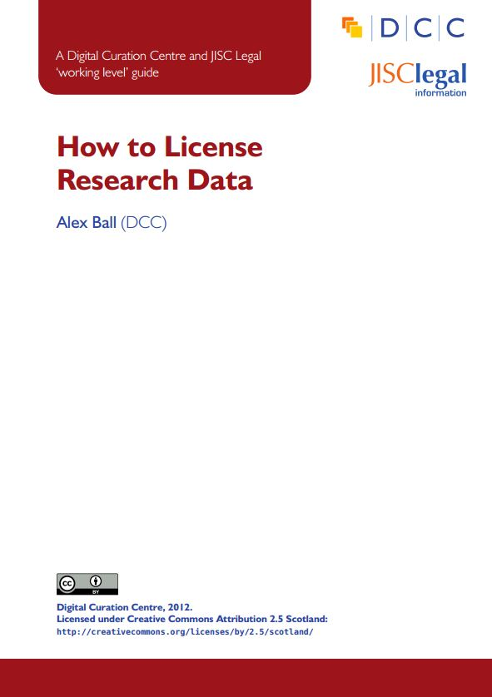
Reviewing DMPs
Useful guidelines
ESRC guidance for peer-reviewers www.esrc.ac.uk/_images/Data-Management-Plan-Guidance-for-peer-reviewers_tcm8-15569.pdf
MRC guidelines www.mrc.ac.uk/documents/pdf /data-management-plans-guidance-for-reviewers
Johns Hopkins grant reviewers cribsheet https://dmp.data.jhu.edu/resources/grant-reviewers-guide
How to assess DMPs forthcoming guide

Slide 16
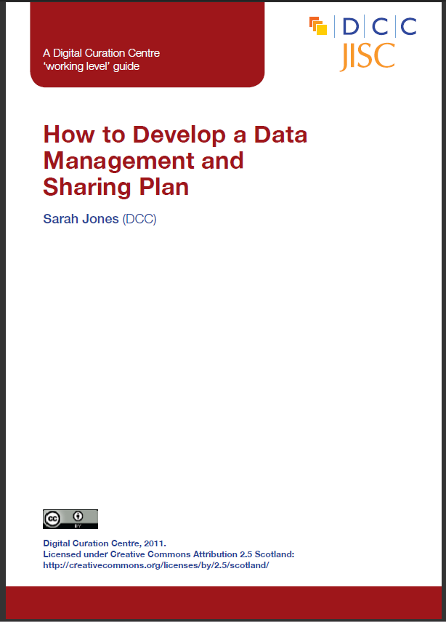
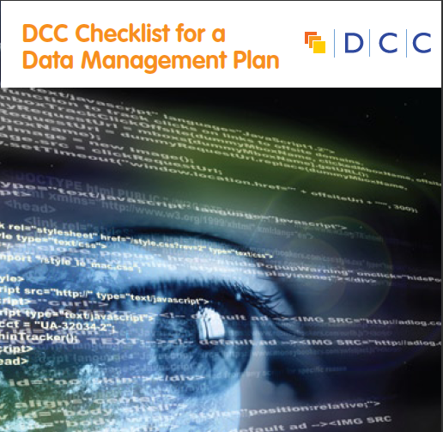

DCC support on Data Management Plans
Checklist on what to include
How to guide on developing a plan
Webinars and training materials
DMPonline tool
Example DMPs
www.dcc.ac.uk/resources/data-management-plans

Slide 17

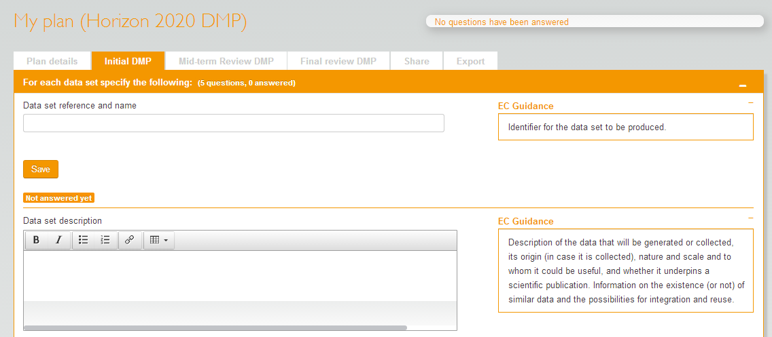
DMPonline
A web-based tool to help researchers write DMPs
Includes a template for Horizon 2020
https://dmponline.dcc.ac.uk

Slide 18
Example data management plans
Technical appendix submitted to AHRC by Bristol Uni
http://data.blogs.ilrt.org/files/2014/02/data.bris-AHRC-example-Technical-Plan.pdf
Rural Economy & Land Use (RELU) programme examples
http://relu.data-archive.ac.uk/data-sharing/planning/examples
UCSD example DMPs (20+ scientific plans for NSF)
http://libraries.ucsd.edu/services/data-curation/data-management/dmp-samples.html
LSHTM guide and worked example for Wellcome Trust
www.lshtm.ac.uk/research/researchdataman/plan/wellcometrust_dmp.pdf
Further examples:
  www.dcc.ac.uk/resources/data-management-plans/guidance-examples

Slide 19
Any questions?
DMP guidance, tools & resources:
www.dcc.ac.uk/resources/data-management-plans
Follow us on twitter:
@digitalcuration and #ukdcc #DMPonline

